Slide 1
Image Processing
Via Zhichao Fu
Overview
RGB-D

Slide 2
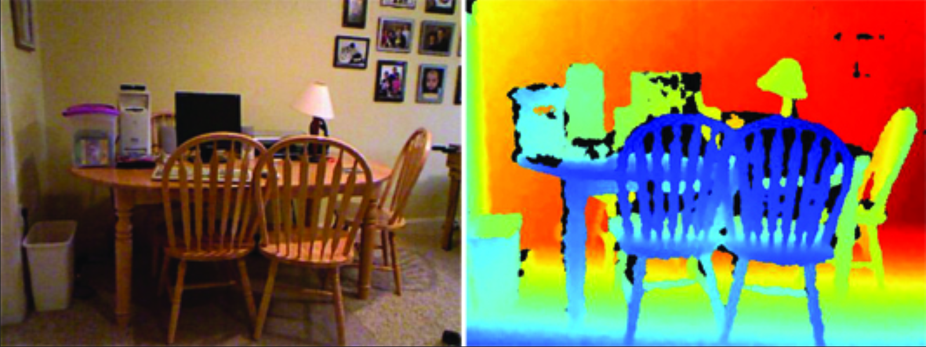
Depth Image
Representation: Gray Image (Channel = 1)
Value: Distance * Scale_Factor (Missing = 0)
Coordinate: corresponding to RGB image
RGB
Depth (Colorized)

Slide 3
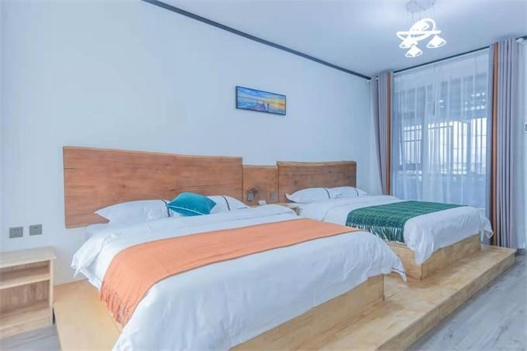
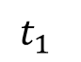
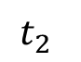
Depth Sampling
Time of Flight (ToF): Capture reflected light and calculate time
Light Source
$$t_{1}$$
c
$$t_{2}$$
Target
Depth
Sensor

Slide 4
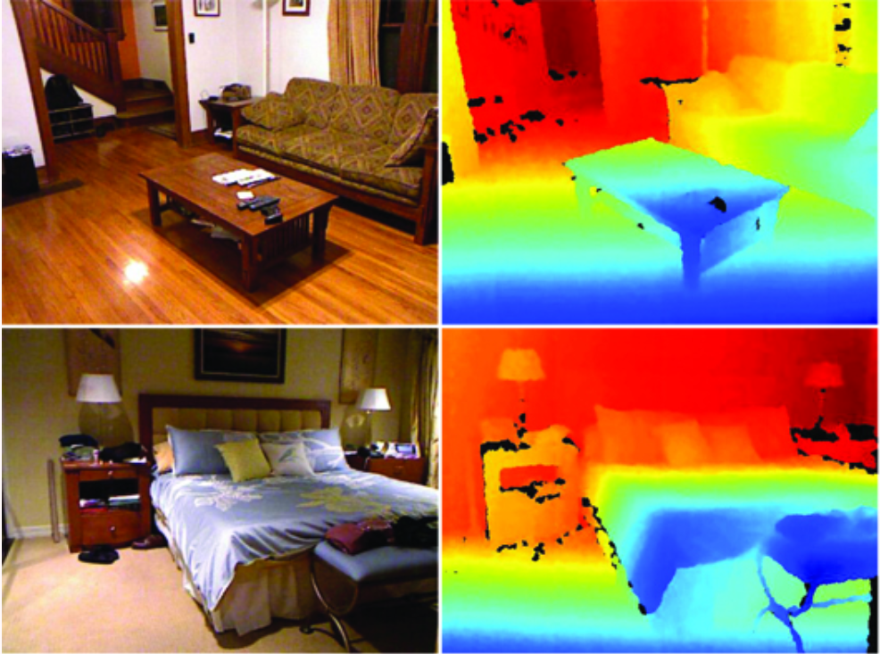
Depth Sampling
Infrared
Indefinite direction
Dense
Low range & accuracy
NYU Depth v2 Dataset

Slide 5
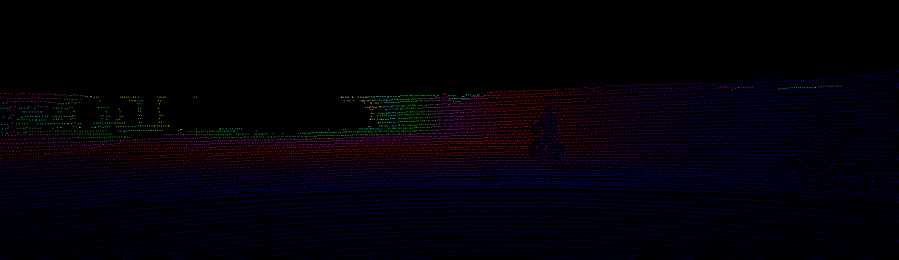
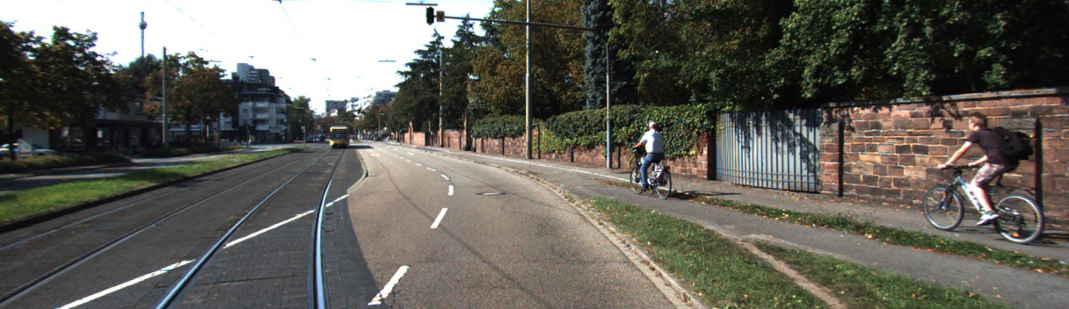
Depth Sampling
LiDAR (Laser)
Definite direction
Sparse
High range & accuracy
KITTI Dataset

Slide 6
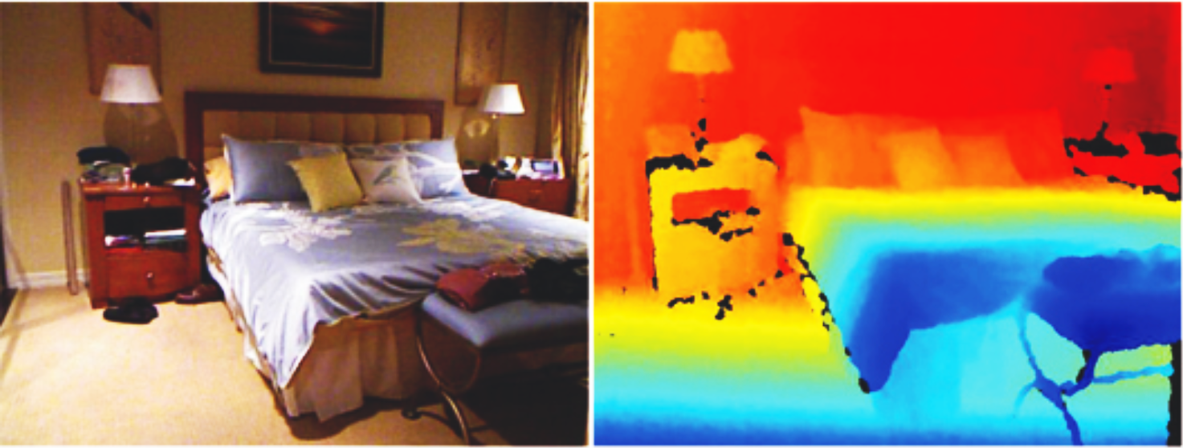
Main Issue of Depth Image
Missing Value

Slide 7
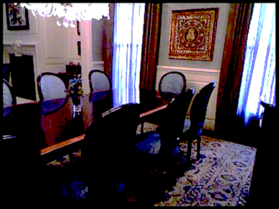
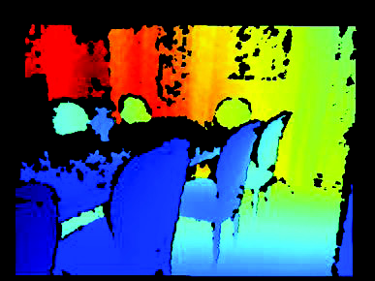
Main Issue of Depth Image
Noise

Slide 8
RGBD Image Processing Tasks

Slide 9
Common Tasks
Depth Estimation
Depth Completion
Depth Refinement
Depth Super-Resolution
Depth Segmentation
…

Slide 10
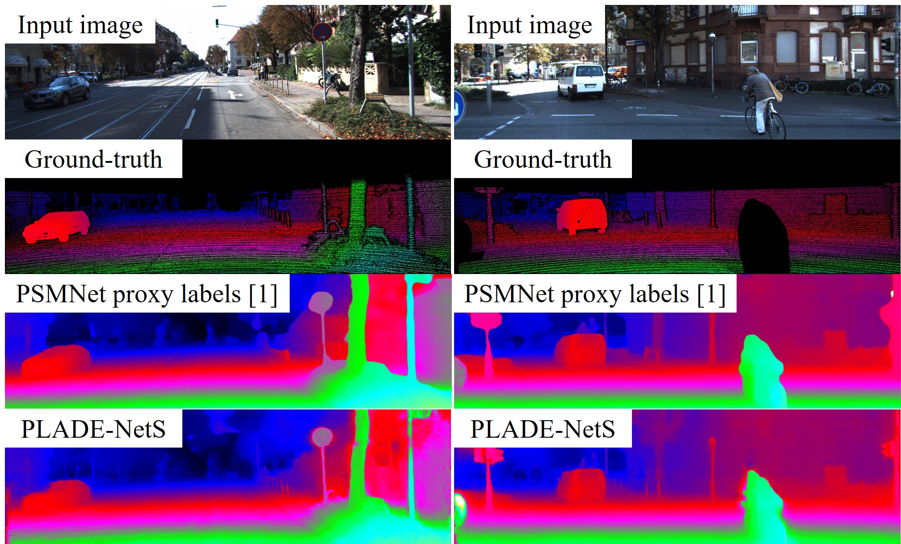
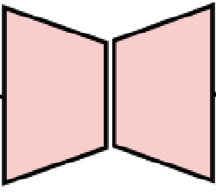
Modal to Modal
RGB → Depth
Sparse Depth → Dense Depth

Slide 11
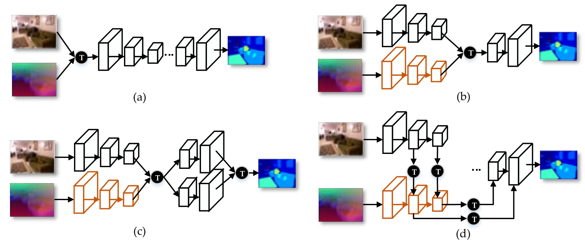
Multi-Modal Fusion
RGB + Sparse Depth → Dense Depth: T = [add, concat]

Slide 12
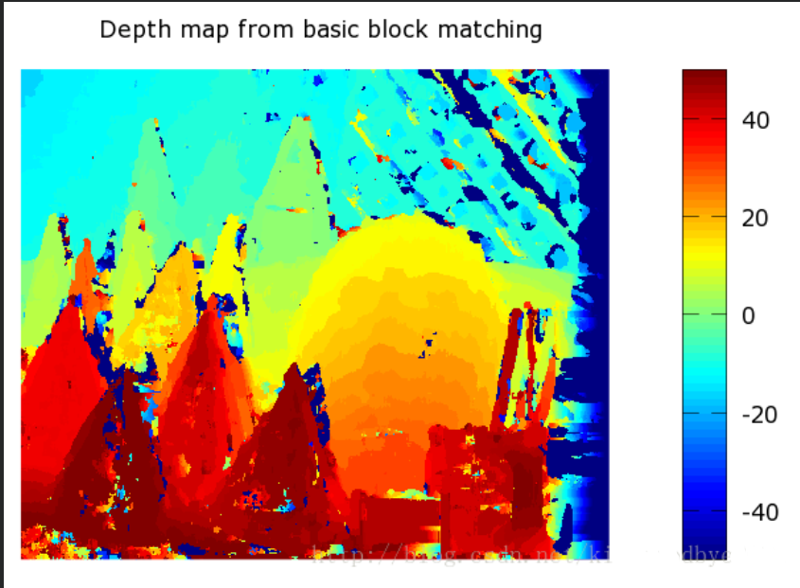
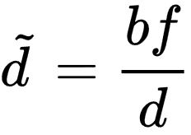
Monocular Depth Estimation
MonoDepth
Stereo Matching: Disparity Map
The center distance of same pattern patches
Distance between cameras
Focal length
Depth
Disparity
Unsupervised Monocular Depth Estimation with Left-Right Consistency

Slide 13
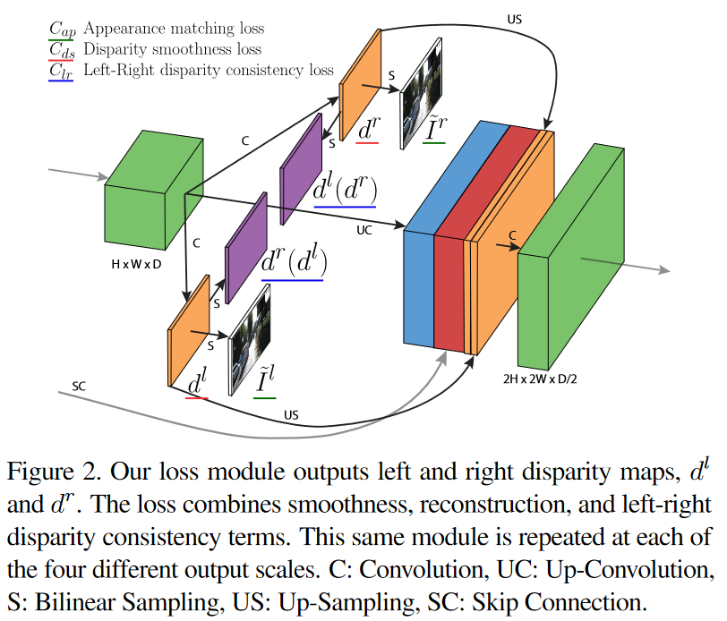
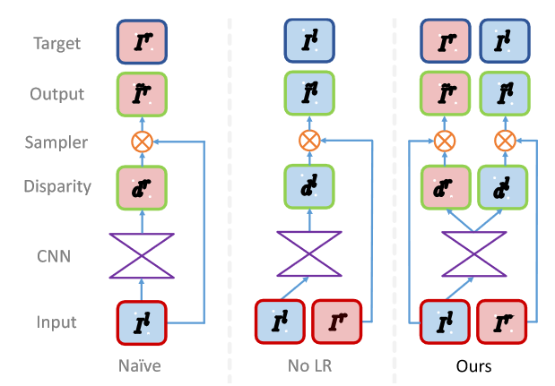
Monocular Depth Estimation
MonoDepth
Unsupervised Monocular Depth Estimation with Left-Right Consistency

Slide 14
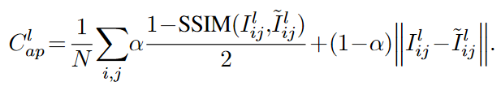
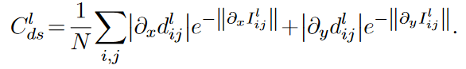
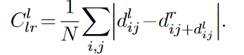
Monocular Depth Estimation
MonoDepth: Loss Function
Appearance Matching Loss
Disparity Smoothness Loss
Left-Right Disparity Consistency Loss
Minimum differences between left disparity with projected right disparity
Unsupervised Monocular Depth Estimation with Left-Right Consistency

Slide 15
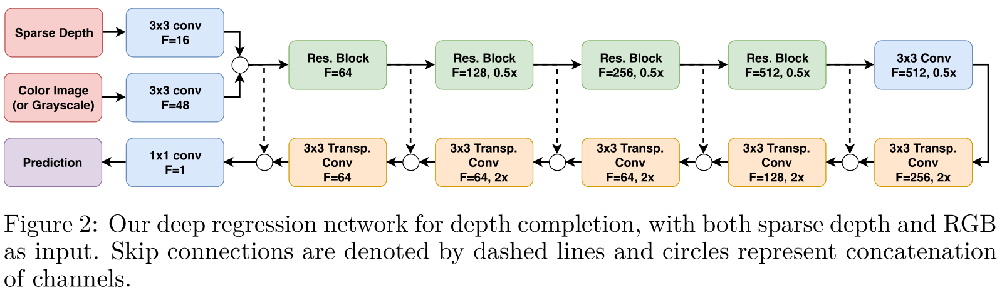
Monocular Depth Estimation
Self-Supervised Sparse-to-Dense: Self-Supervised Framework
Self-Supervised Sparse-to-Dense: Self-Supervised Depth Completion from LiDAR and Monocular Camera

Slide 16
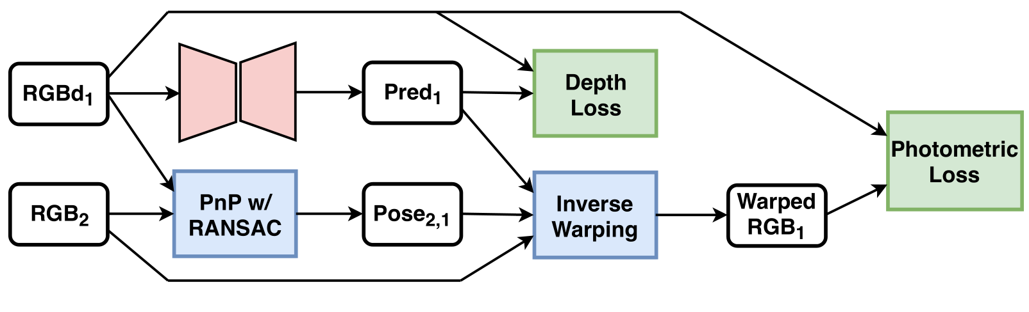
Monocular Depth Estimation
Self-Supervised Sparse-to-Dense: Self-Supervised Framework
Only for missing depth
Self-Supervised Sparse-to-Dense: Self-Supervised Depth Completion from LiDAR and Monocular Camera

Slide 17
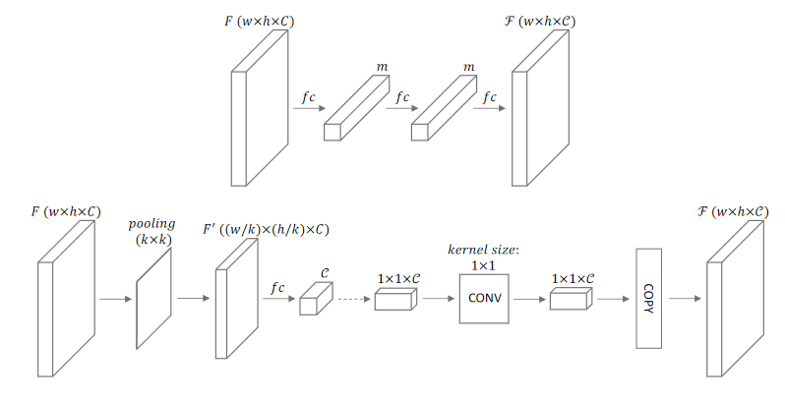
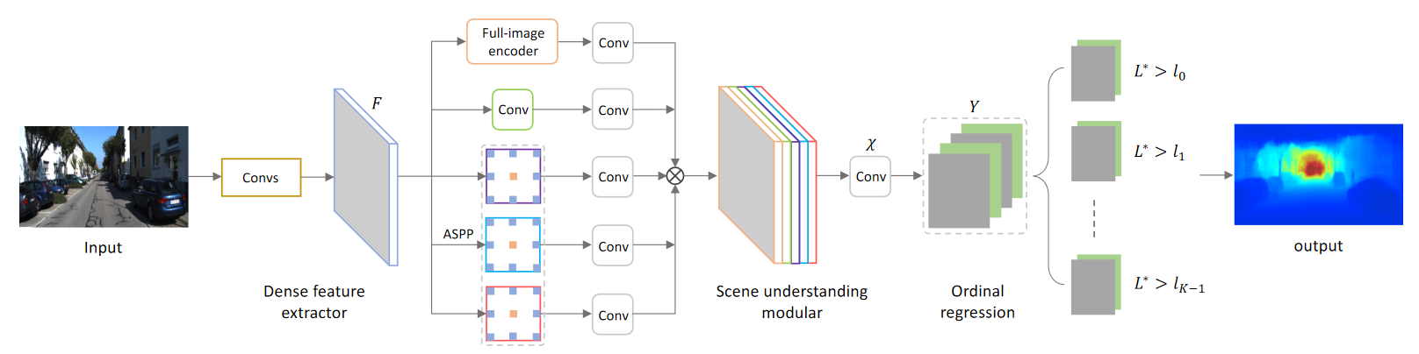
Monocular Depth Estimation
DORN
Channel Attention
Deep Ordinal Regression Network for Monocular Depth Estimation

Slide 18
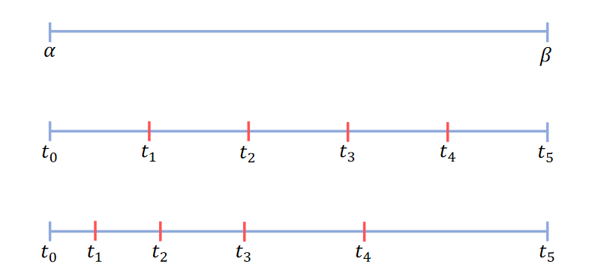
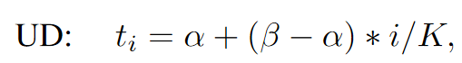
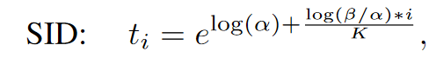
Monocular Depth Estimation
DORN: Spacing-Increasing Discretization
(Depth Regression → Range Classification)
Deep Ordinal Regression Network for Monocular Depth Estimation

Slide 19
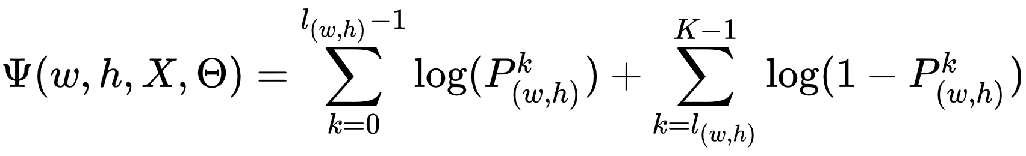
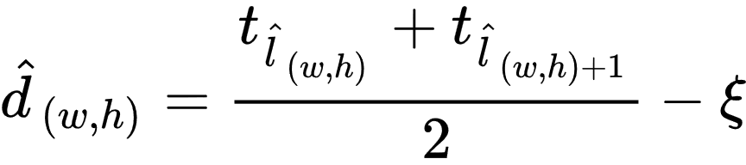
Monocular Depth Estimation
DORN: Training & Inference
Training
Inference
with Sliding Window
Deep Ordinal Regression Network for Monocular Depth Estimation

Slide 20
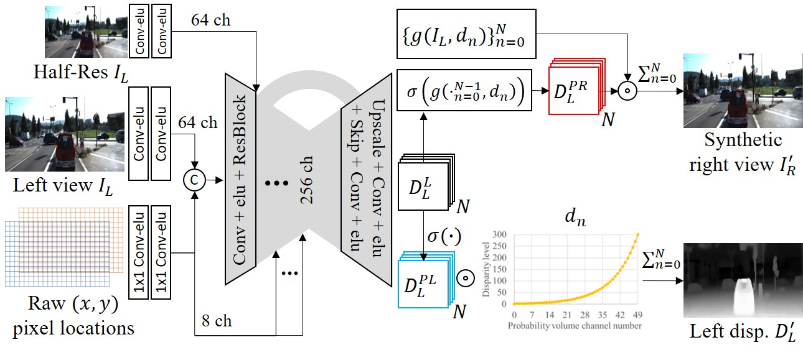
Monocular Depth Estimation
PLADE-Net
PLADE-Net: Towards Pixel-Level Accuracy for Self-Supervised Single-View Depth Estimation with Neural Positional Encoding and Distilled Matting Loss

Slide 21
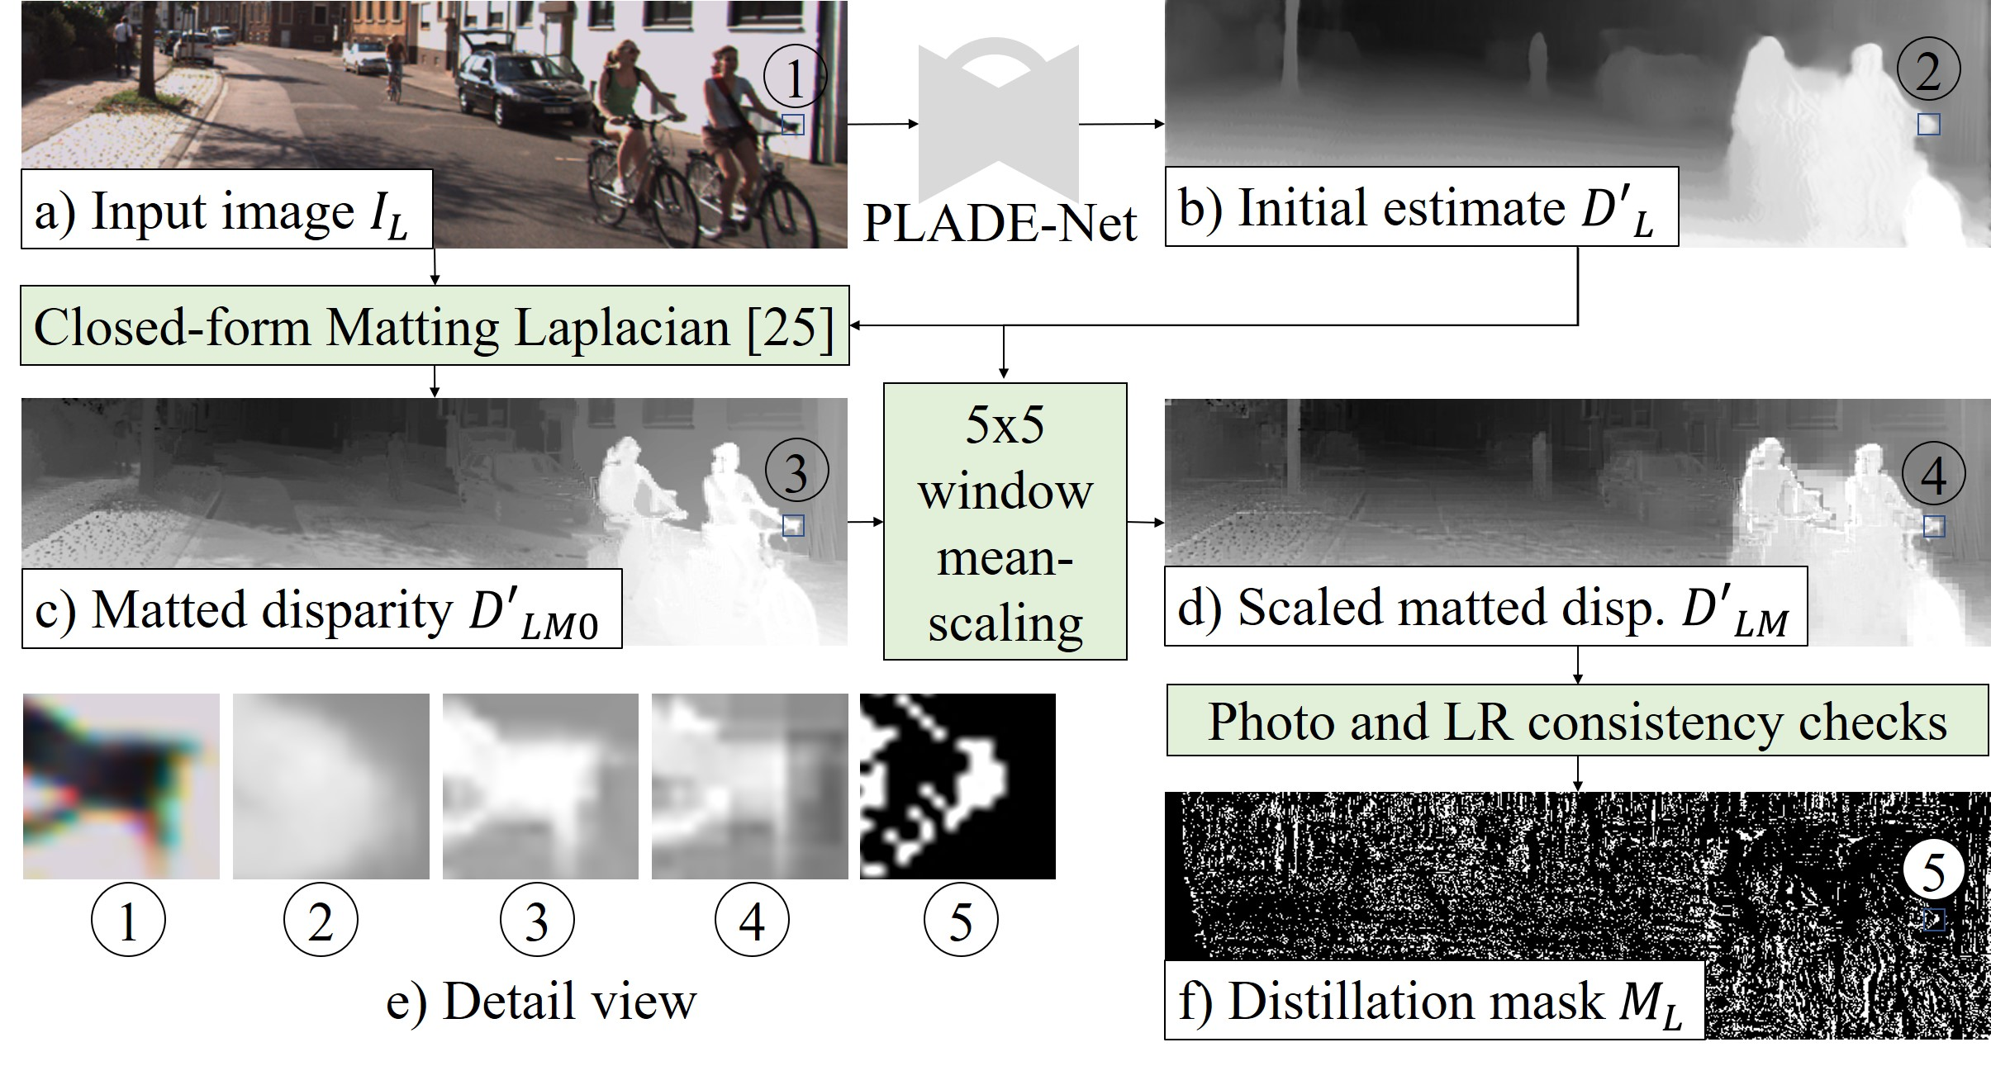
Monocular Depth Estimation
PLADE-Net: Post-processing
PLADE-Net: Towards Pixel-Level Accuracy for Self-Supervised Single-View Depth Estimation with Neural Positional Encoding and Distilled Matting Loss

Slide 22
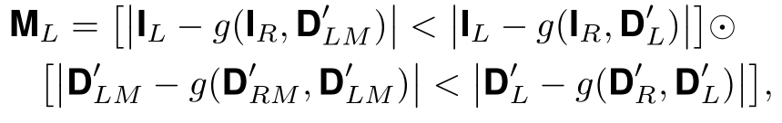
Monocular Depth Estimation
PLADE-Net: After-processing
Photometric and Left-right Consistency Checks
PLADE-Net: Towards Pixel-Level Accuracy for Self-Supervised Single-View Depth Estimation with Neural Positional Encoding and Distilled Matting Loss

Slide 23
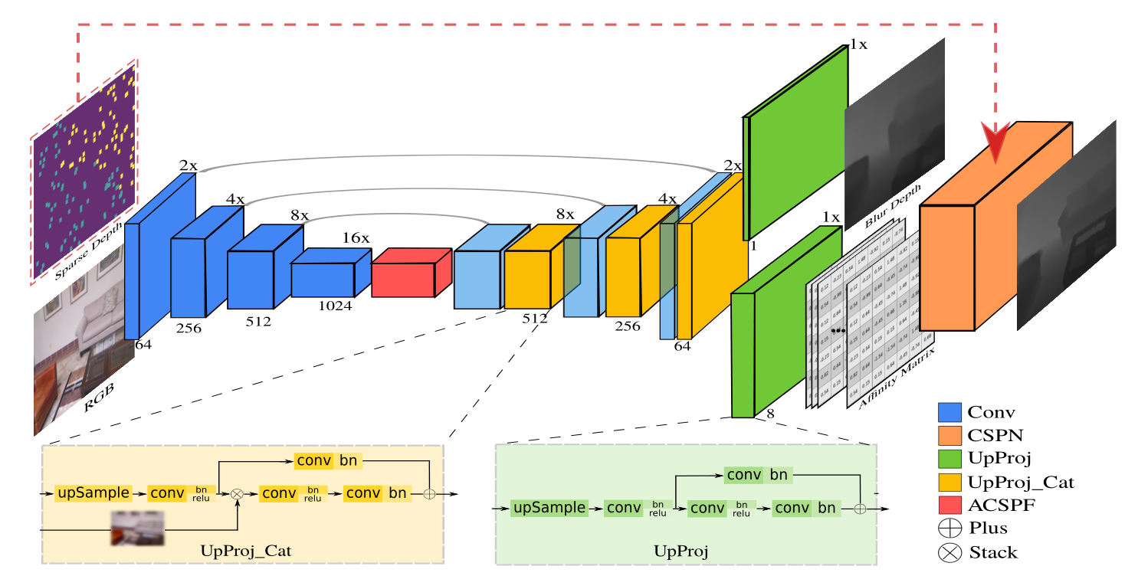
Depth Completion
CSPN: Total Network
Learning Depth with Convolutional Spatial Propagation Network

Slide 24
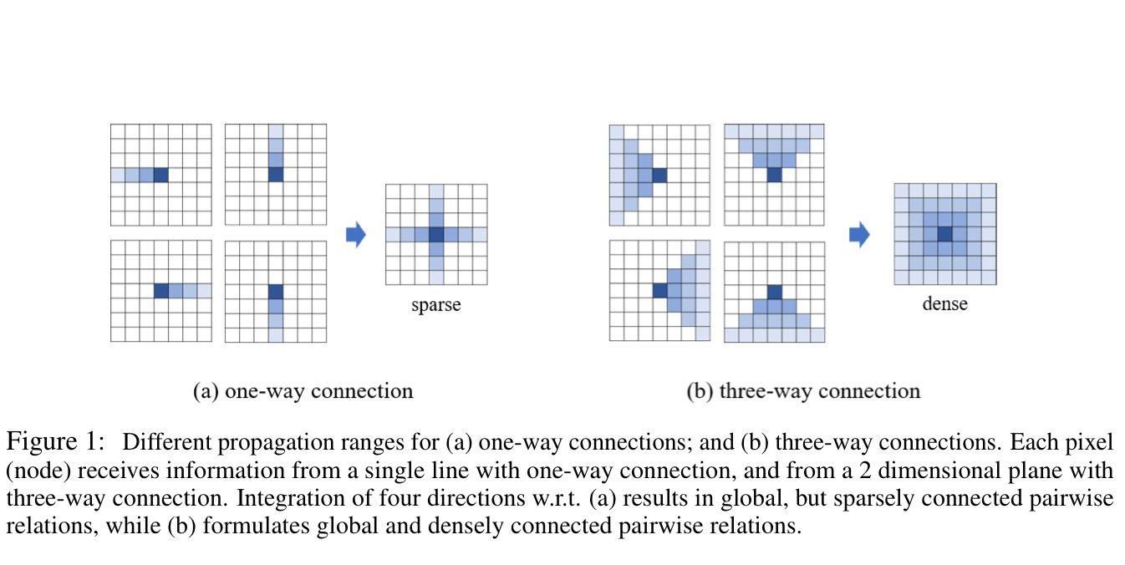
Depth Completion
CSPN
Learning Depth with Convolutional Spatial Propagation Network

Slide 25
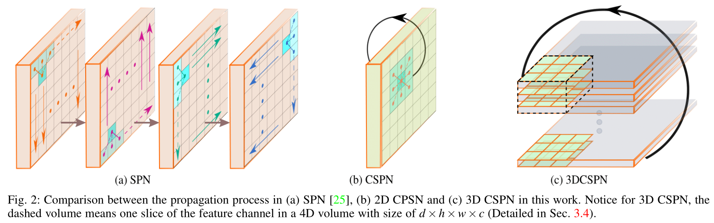
Depth Completion
CSPN
Learning Depth with Convolutional Spatial Propagation Network

Slide 26
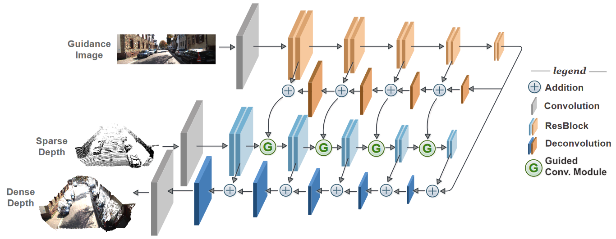
Depth Completion
Guided Convolutional Network
Learning Guided Convolutional Network for Depth Completion

Slide 27
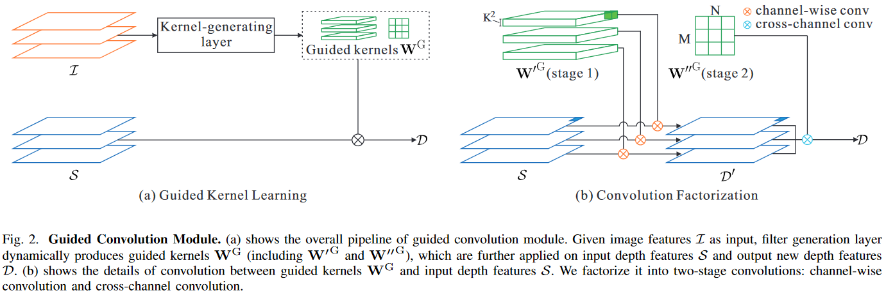
Depth Completion
Guided Convolutional Network
Learning Guided Convolutional Network for Depth Completion

Slide 28
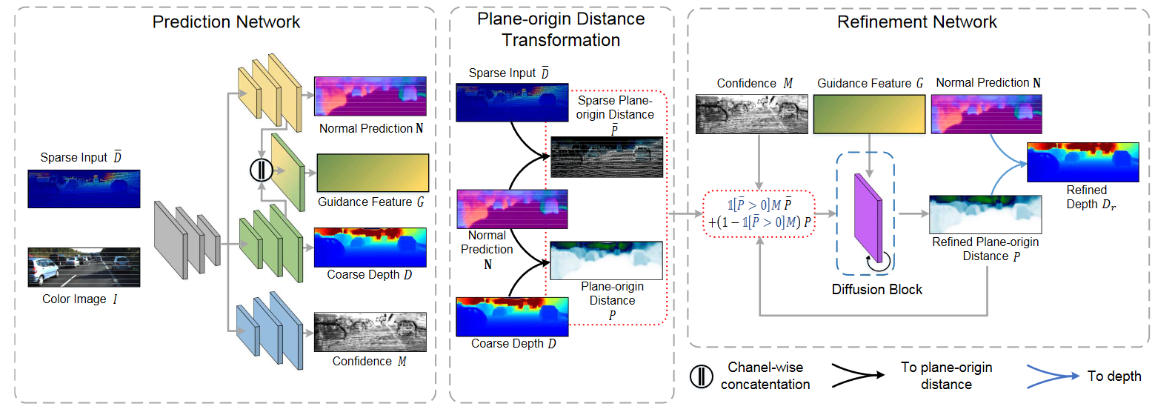
Depth Completion
Depth-Normal Constraints: Overview
Depth → Normal+Plane → Normal+Completed Plane → Completed Depth
Depth Completion from Sparse LiDAR Data with Depth-Normal Constraints

Slide 29
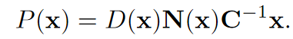
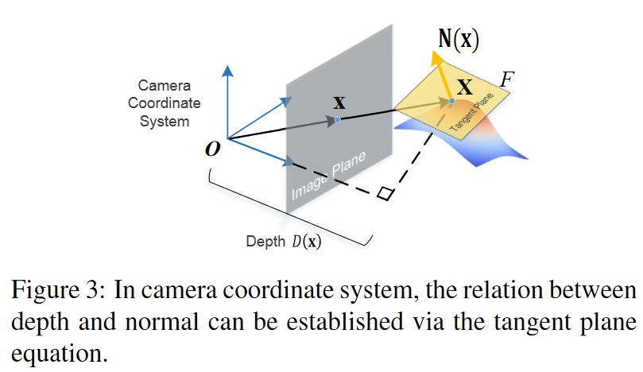
Depth Completion
Depth-Normal Constraints: Surface Normal Matrix
Normal Calculation from Depth GT
Each point in sparse depth image
KNN
Nearest 3D points
PCA
Normal Vector
Depth Completion from Sparse LiDAR Data with Depth-Normal Constraints

Slide 30
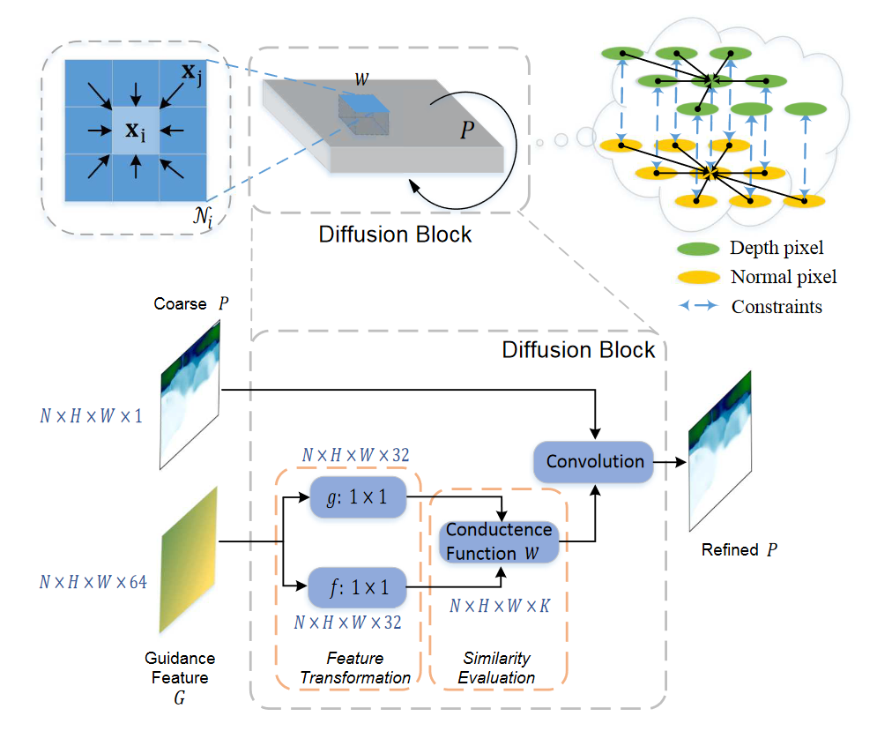
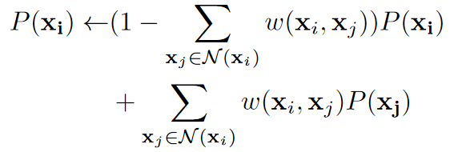
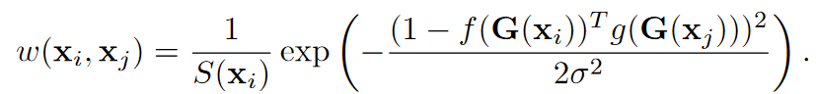
Depth Completion
Depth-Normal Constraints: Recurrent Refinement
Defussion Refinement
Kernel weight: probability on same plane
Normalization
Depth Completion from Sparse LiDAR Data with Depth-Normal Constraints

Slide 31
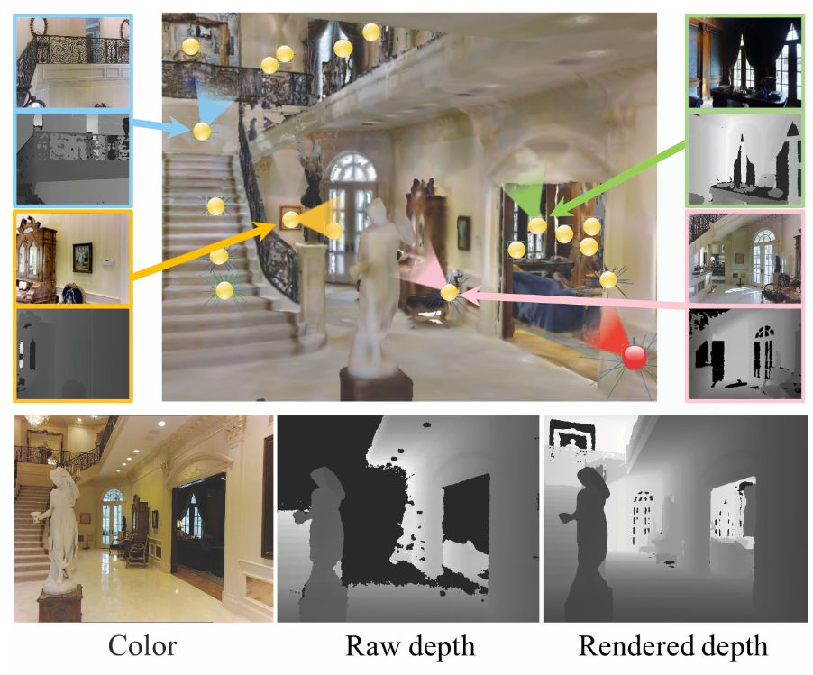
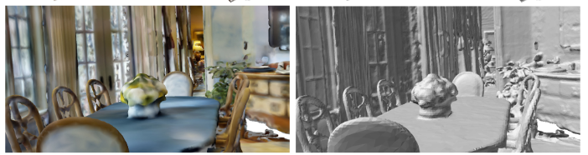
Depth Completion
DeepCompletion: Build supervised data
Multi-view RGB-D Images
Screened Poisson Surface Reconstruction
Reconstructed 3D Mesh
Deep Depth Completion of a Single RGB-D Image

Slide 32
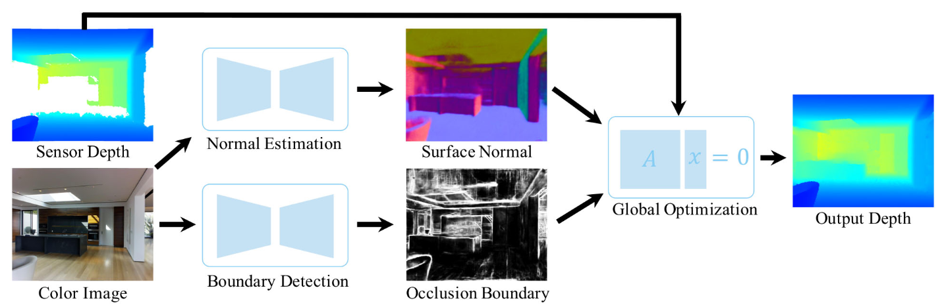
Depth Completion
DeepCompletion: Pipeline
Deep Depth Completion of a Single RGB-D Image

Slide 33
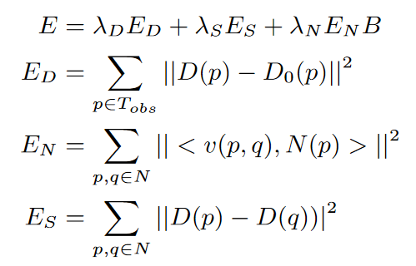
Depth Completion
DeepCompletion: Optimization
Boundary
Distance between
the estimated depth and the observed raw depth
Consistency between
the estimated depth and the predicted surface normal
Tangent Vector
Adjacent pixels to have the same depths
Deep Depth Completion of a Single RGB-D Image

Slide 34
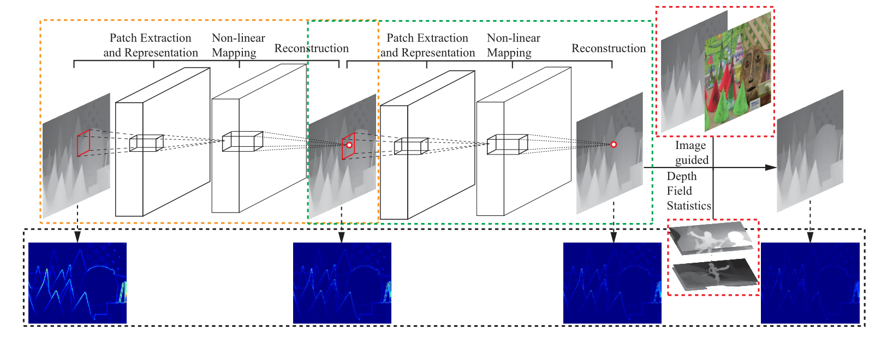
Depth Super-Resolution
Deep Depth Super-Resolution
Deep Depth Super-Resolution : Learning Depth Super-Resolution using Deep Convolutional Neural Network

Slide 35
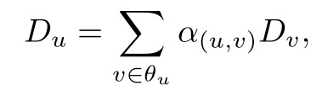
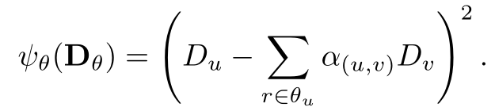

Depth Super-Resolution
Deep Depth Super-Resolution: Color modulated smoothness
For each pixel u, use color in neighborhood $θ_{u}$ for smoothness
Deep Depth Super-Resolution : Learning Depth Super-Resolution using Deep Convolutional Neural Network

Slide 36

Depth Super-Resolution
Edge-aware Depth SR
Depth upsampling based on deep edge-aware learning

Slide 37

Depth Super-Resolution
Edge-aware Depth SR: Generate Edge Map
Depth upsampling based on deep edge-aware learning

Slide 38

Depth Super-Resolution
Edge-aware Depth SR: Depth Filling (Calculate Overlap & Cross)
Depth upsampling based on deep edge-aware learning

Slide 39

Depth Super-Resolution
Edge-aware Depth SR: Depth Filling (Network)
Depth upsampling based on deep edge-aware learning

Slide 40

Depth Super-Resolution
PMBANet
PMBANet: Progressive Multi-Branch Aggregation Network for Scene Depth Super-Resolution

Slide 41

Depth Super-Resolution
PMBANet: Forward & Back in Reconstruction Branch
PMBANet: Progressive Multi-Branch Aggregation Network for Scene Depth Super-Resolution

Slide 42

Depth Super-Resolution
PMBANet: Fusion
PMBANet: Progressive Multi-Branch Aggregation Network for Scene Depth Super-Resolution

